Slide 1
Student Garda Vetting
Karyn Ryan, Admissions

Slide 2
Background of Garda Vetting
The National Vetting Bureau (Children and Vulnerable Persons) Acts 2012 to 2016 (the Act) provides a statutory basis for mandatory vetting of persons (including students) who wish to undertake work placements and/or any other activities that amount to “Relevant Work or Activities” for the purpose of the Act.

Slide 3
In summary, the phrase “Relevant Work or Activities” encompasses a wide array of work and activities that involve contact with or access to children and/or vulnerable adults. Schedule 1 of the Act sets out a list of what specifically constitutes “Relevant Work or Activities” for the purpose of the Act

Slide 4
All students or applicants in receipt of an offer, on the following programmes will be subject to Vetting and it must be completed as part of your college registration.
Programmes subject to Vetting

Slide 5
Undergraduate Programmes
SG134 Applied Sport with Business
SG135 Tourism with Event Management (level 7)
SG148 Tourism with Event Management (level 8)
SG147 Sport with Business
SG235 Performing Arts (Theatre Design)
SG236 Performing Arts (Acting)
SG243 Social Care Practice
SG241 Performing Arts
SG242 Early Childhood Care and Education
SG247 English and Psychology
SG248 Sociology and Politics
SG249 Writing and Literature
SG406 Health and Exercise Science
SG435 Health Science and Physiology
SG447 Health Science and Physical Activity

Slide 6
Post Graduate Programmes
Masters of Arts in Social Work
Postgraduate Diploma / Masters in Social Care and Social Justice
Post Graduate Diploma / Master of Arts in Leadership and Advocacy in the Early Years

Slide 7
Garda Vetting Procedure

Slide 8
Vetting Invitation Form

Slide 9
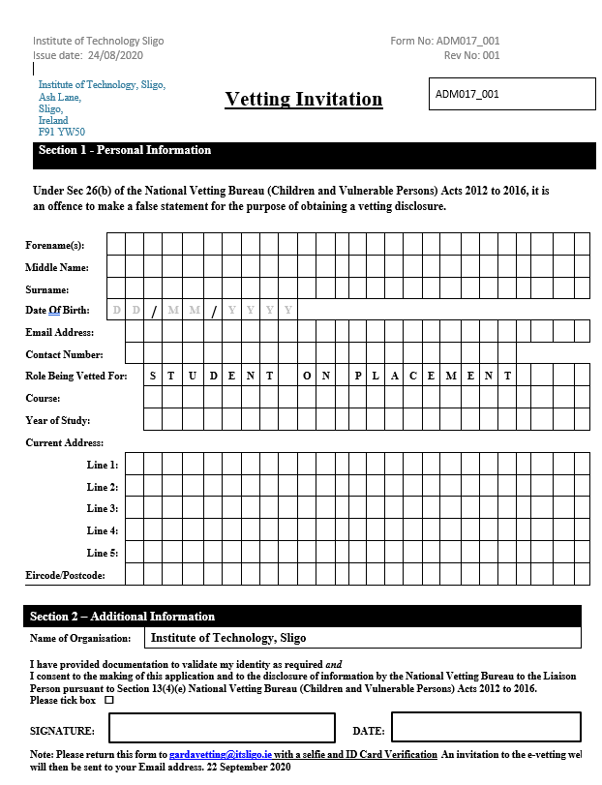
Vetting Invitation

Slide 10
Completed Vetting invitation forms AND Selfie and ID Card Verification must be returned to:
gardavetting@itsligo.ie
If invitation or Selfie/ID Verification are not completed correctly, both will be returned to you for amending. This could cause a delay in your Vetting invitation being processed.

Slide 11
Once your Vetting Invitation and Selfie/ID Verification are received, your details will be entered on the National Vetting Bureau website. An email will then be sent to your student email address, with a link, asking you to complete an online form in more detail. This must be completed within 30 days of receiving this link otherwise your invitation expires and you will have to start the process again.

Slide 12
Important Information
Currently, the turn around time for completion of Garda Vetting is 9-10 working days from when you first submit your Invitation and Selfie/ID Verification.
To ensure your Garda Vetting is processed on time, you are requested to complete your Vetting as part of your college registration.

Slide 13
Questions
Should you have any questions relating to the Garda Vetting Process, please feel free to contact us by email and we will be happy to assist you:
gardavetting@itsligo.ie

