Slide 1
University Learning in North West Ireland.
The impact of the implementation of the UDL principles on a Nursing Practice Skills Module.
Presented By: Dr Dympna Walsh-Gallagher
School of Nursing, Health Sciences and Disability Studies,
St Angela’s College, Sligo

Slide 2
Background
Modern-day Irish society
Changes in Nurse Education
Diversity
Inclusion
UDL-principles and application

Slide 3
Introduction
Nursing Practice Skills 4 (Intellectual Disability)
Within this module, students will have the opportunity to further develop knowledge and competence in advanced nursing skills of health, communication and advocacy.
TEACHING AND LEARNING ACTIVITIES/STRATEGIES
Lectures, tutorials, seminars, on-line learning, individual and group work, digital media, simulation, concept mapping, practical skills sessions, supervised practice, unobtrusive supervision, role plays, problem-based learning and reflection.
Assessment for the module:
Etivity (20%) and OSCE (80%)

Slide 4
UDL IMPLEMENTATION
Clinical Skills Manager and DPA staff
Setting the Scene
Effective Communication
Safe Environment for Everyone
Inclusive to EVERYONE!

Slide 5
Impact of UDL implementation
Sarah said ”I found the teachings of supporting someone in the last 24 hours of life to be a successful learning process. ..It has been an honour to learn how to adequately support a person, and their loved ones through the last 24 hours of life. I found the teachings very applicable to practice as following the module I had the honour to support someone in their final few hours and it was comforting to know that from your teachings that just being present and offering a hand to hold or a cup of tea to a loved one can provide such emotional and physical comfort…an individuals wishes for the end of life is important and that these are implemented. I do also think that the stimulated environment and your experience added to our learning… much needed in our course and will be implemented in practice.”
Orla stated: “ I thoroughly enjoyed this style of teaching. This module was very insightful into our learning in practice and it was valuable to hear of the process in which to care for someone and their families during these times. Being able to relate theory to practice…”

Slide 6
Paula said: “Dympna, your class on the last 24 hour of care pre and post death was beautiful. The peaceful atmosphere, the smaller classs size gave such a personal touch and allowed me to reflect on the reality of dying. From experiencing my own father's death, your explanation of what was happening helped me accept everything that could be done for him was carried out with dignity and respect. You explained the importance of having family to support the dying person and each other which I can relate to as well. ..we treated the dead as if they were alive when preparing them by talking to them and the dignity and respect for the body afterward. Dympna, you addressed a very sensitive subject very well. I personally think that the last 24 hour's of someone Life is a privilege and honour. You dealt with it so well. Culture was well addressed and this is so relevant in the current multicultural society that we live in. Thank you …”.

Slide 7
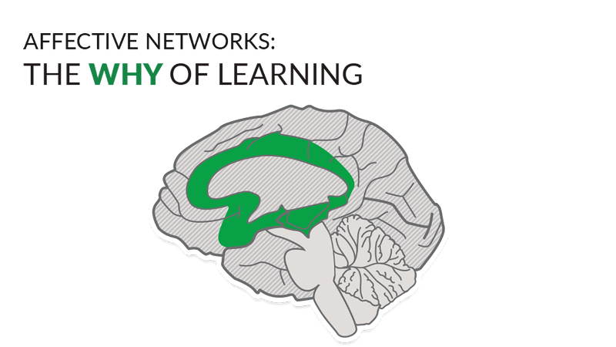
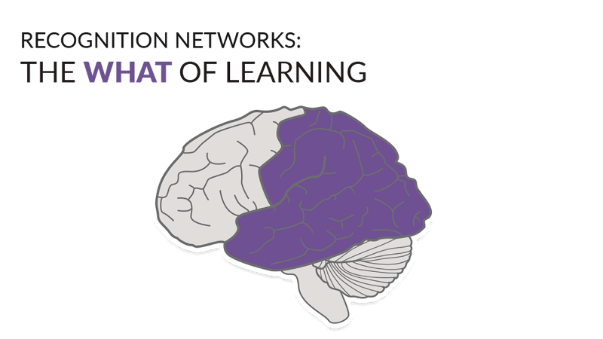
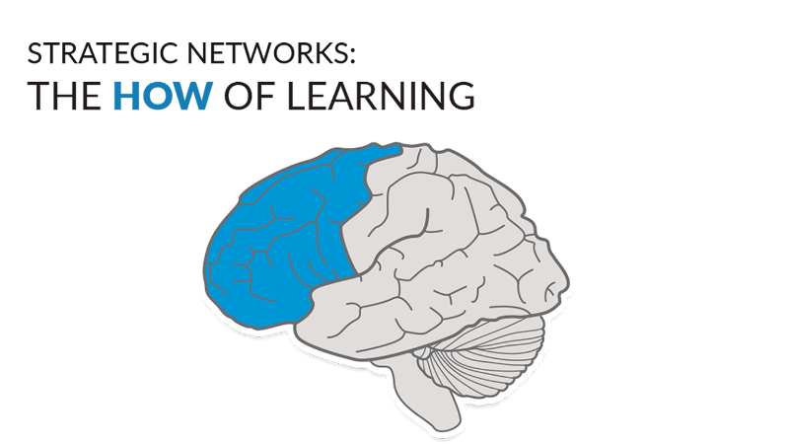
Clodagh: “I hope this email finds you well. I felt you taught the last 24 hours of care pre and post death excellent. I felt you were very respectful, open minded and culturally knowledgeable regarding rituals in the last 24 hours of care pre and post death. I felt comfortable from the onset as you stated if you need to step out of the classroom to do so and how death can be a challenging aspect to talk about as many people can empathise/ relate to losing a loved one or supporting an individual in there last 24hrs on this earth, I felt you were very respectful when conversions occurred as a group with my peers speaking about their own experiences. ”
Conclusion: Merge our talents!
Recommendations:
Continue to implement the UDL principles in all theoretical and practical modules.

Slide 8
Recourses:
https://www.cast.org/impact/universal-design-for-learning/accesssed 11/05/2022.
https://ideal.com/diversity-and-inclusion/accessed 20/05/2022.
http://hdl.handle.net/10197/10154.

Slide 9
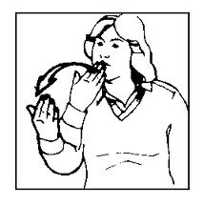
Thank you for your attention
Special Thanks to:
my family, friends, DPA team,
St Angela's SNSDS, UDL team,
to you all for listening and
most especially to all the students who participated in the module.

